Slide 1
Manipulator Functions

Slide 2
Manipulator Functions
These are stream functions that change I/P or O/P characteristics.
Header file used: <iomanip>

Slide 3
Predefined Manipulators
Manipulators | Meanings
endl | Generates a carriage return
ends | Attach a null terminating character (‘\0’) at end of string
flush | Cause stream associated with o/p to be completely emptied
hex, dec, oct | Set base for integers
resetiosflags | Clears specified flags
setbase | Set base for integers
setfill | Set character that will be used to fill spaces in right-justified display
setiosflags | Set the specified flags
setprecision | Sets precision for floating point values
setw | Specifies width of display fields
ws | Ignores leading white space that preceeds first field

Slide 4
ends example
int number = 231;
cout << ‘\ ” ’ <<“number = ” <<number <<ends;
O/p: “number = 231 “

Slide 5
flush example
cout<< “C++, World \n”;
cout.flush();
Note: It is required in case of disk file being copied to another; it has to flush o/p buffer prior to re-writing the o/p file for continued use.

Slide 6
setbase example
cout<< “Enter number”;
cin>> value;
cout<< “Hexadecimal Base = “ << setbase(16) <<value;
o/p: Enter number
15
Hexadecimal Base = f

Slide 7
setw example
int a = 200, b = 300;
cout<< setw(5) << a << setw(5) << b << endl;
cout<< setw(6) << a << setw(6) << b << endl;
cout<< setw(7) << a << setw(7) << b << endl;
o/p: 200 300
200 300
200 300

Slide 8
setfill example
int a = 200, b = 300;
cout<< setfill(‘*’);
cout<< setw(5) << a << setw(5) << b << endl;
cout<< setw(6) << a << setw(6) << b << endl;
cout<< setw(7) << a << setw(7) << b << endl;
o/p: **200**300
***200***300
****200****300

Slide 9
setprecision example
float a,b,c;
a = 5, b = 3;
c = a/b;
cout<< setprecision(1) << c << endl;
cout<< setprecision(2) << c << endl;
cout<< setprecision(3) << c << endl;
o/p: 2
1.7
1.67

Slide 10
ws example
cout<< “Enter a line of text \n”;
cin>> ws;
cin >> name;
cout<< “typed name = “ << name;
o/p: Enter a line of text
this is a test
typed text = this

Slide 11
setiosflags and resetiosflags example
int num;
cout<< “Enter a number”;
cin>> num;
cout<< “Default display decimal= “ << num <<endl;
cout.setf(ios::oct, ios::basefield);
cout<< “Octal = “ << num << endl;
cout.setf(ios::hex, ios::basefield);
cout<< “Hexadecimal = “ << num << endl;
o/p: Enter a number
15
default display decimal = 15
Octal = 17
Hexadecimal = f

Slide 12
Scope

Slide 13
Local and Global Variables
Variables defined inside a function are local to that function. They are hidden from the statements in other functions, which normally cannot access them.
Because the variables defined in a function are hidden, other functions may have separate, distinct variables with the same name.

Slide 14
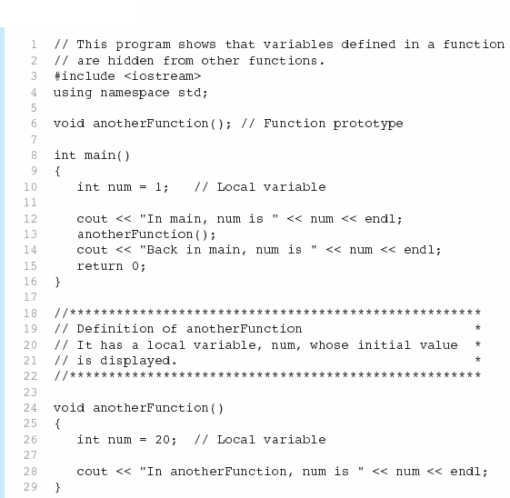


Slide 15

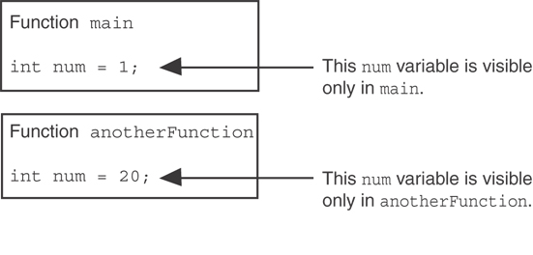
When the program is executing in main, the num variable defined in main is visible. When anotherFunction is called, however, only variables defined inside it are visible, so the num variable in main is hidden.

Slide 16
Local Variable Lifetime
A function’s local variables exist only while the function is executing. This is known as the lifetime of a local variable.
When the function begins, its local variables and its parameter variables are created in memory, and when the function ends, the local variables and parameter variables are destroyed.
This means that any value stored in a local variable is lost between calls to the function in which the variable is declared.

Slide 17
Global Variables & Global Constants
A global variable is any variable defined outside all the functions in a program.
The scope of a global variable is the portion of the program from the variable definition to the end.
This means that a global variable can be accessed by all functions that are defined after the global variable is defined.

Slide 18
Global Variables & Global Constants
You should avoid using global variables because they make programs difficult to debug.
Any global that you create should be global constants.

Slide 19
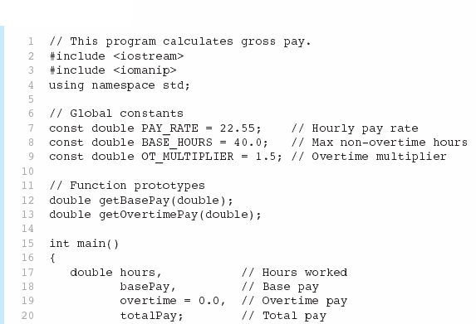

Global constants defined for values that do not change throughout the program’s execution.

Slide 20
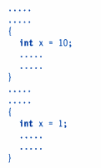
Scope resolution operator
2 declarations of ‘x’ refers to 2 different memory locations here

Slide 21
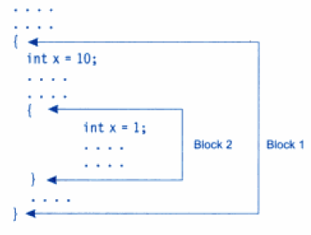
Declaration in inner block hides declaration in outer block.

Slide 22
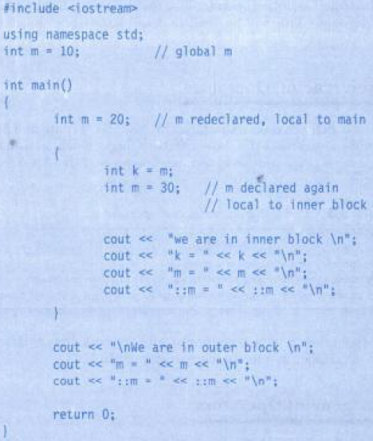


Scope Resolution operator

Slide 23
Recursive Function
Function calling itself directly or in-directly again & again.
Advantages:
  Recursive call is faster
  Minimum transfer of control
  Take less memory than normal functions
  Code size becomes small
Disadvantage:
  Developing, testing and maintaining is difficult

Slide 24
Recursive Function example
void fun(); //function declaration
void main()
{
--------
fun(); //function call
-------
}
fun() //function definiton
{
-----
fun(); //function calls itself recursively
-------
}

Slide 25
Recursive Function example
long int fact(long int);
int main()
{
long int x, n;
cout<< “Enter any integer no. \n”;
cin>> n;
x = fact(n);
cout<< “value = “ << n <<“and factorial” << x;
return 0;
}
long int fact(long int n)
{
int value = 1;
if(n==1)
return (value);
else
{
value = n * fact(n-1);
return (value);
}
}

Slide 26
Pointer to Function
General syntax:
  Return_type (*variables) (list of parameters)
Example:
  void (*ptr) (float, float, int);
Note: Address of function must be assigned to pointer:
  ptr = &average //where average is function name

Slide 27
Pointer to Function example
float average(float, float, float);
void main()
{
float a, b, c, avg;
float (*ptrf) (float, float, float);
ptrf = &average;
cout<< “Enter 3 nos.”;
cin>> a >> b >> c;
avg = (*ptrf) (a,b,c);
cout << “Average = “ << avg;
}
float average(float x, float y, float z)
{
float temp = (x+y+z)/3;
return (temp);
}

